Slide 1

Laravel Framework & Career Opportunities
Dr. Ronak Panchal
Ph.D in Computer Science
IT Project Manager, Cognizant, Pune
Website blog: http://drronakpanchal.wordpress.com

Slide 2
Hello Laravel

Slide 3
What is Laravel Framework?

Slide 4

What is Laravel ?
Laravel is a free, open-source PHP web framework created by Taylor Otwell and intended for the development of web applications following the model-view-controller (MVC) architectural pattern.
Dr. Ronak Panchal drronakpanchal.wordpress.com

Slide 5
How MVC Work ?
Model:
Mode is a class that maps to the data relation (table)
View
View will be represent HTML Code
Controller
Where Logic code will be placed.
Dr. Ronak Panchal drronakpanchal.wordpress.com

Slide 6
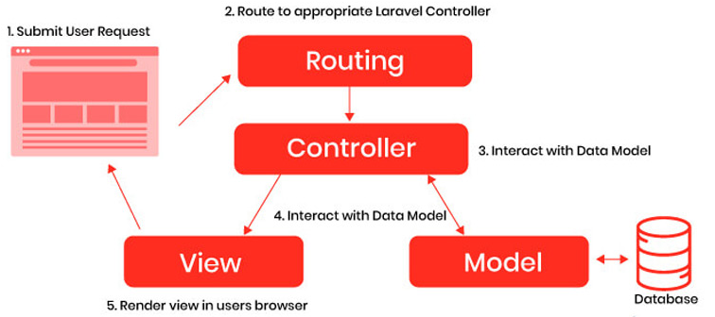
How MVC Work ?
Model:
Mode is a class that maps to the data relation (table)
View
View will be represent HTML Code
Controller
Where Logic code will be placed.
Dr. Ronak Panchal drronakpanchal.wordpress.com

Slide 7
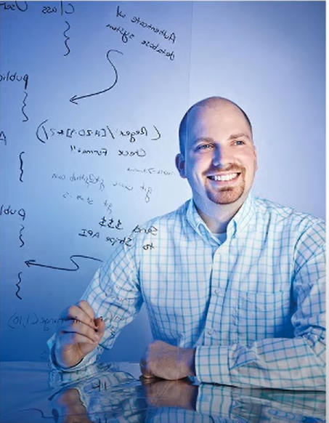
Laravel History
Taylor Otwell invented Laravel in June 2011. Since then, it has been worth of talk among the developers.
Taylor Otwell created Laravel as an attempt to provide a more advancedalternative to the Codelgniter framework, which did not provide certainfeatures such as built-in support for user authentication and authorization.
Laravel Release Notes
Laravel 5.7
Laravel 5.6
Laravel 5.5
Laravel 5.4 [January 24, 2017]
Laravel 5.3 [August 23, 2016]
Laravel 5.2 [December 21, 2015]
Laravel 5.1 [June 9, 2015]
Laravel 5.0 [February 4, 2015]
Laravel 4.2 [June 1, 2014]
Laravel 4.1 [December 11, 2013]
Laravel 4.0 [May 28, 2013]
Laravel 3.2 [May 22, 2012]
Laravel 3.1 [March 27, 2012]
Laravel 3.0 [February 22, 2012]
Laravel 2.0 [September 2011]
Laravel 1.0 [June 2011]
Dr. Ronak Panchal drronakpanchal.wordpress.com

Slide 8
Laravel Features
Unit Testing: Laravel is built with unit testing in mind. In fact, support for testing with PHPUnit is included out of the box, and a phpunit.xml file is already setup for yourapplication.
Database Query Builder: Laravel provides fluent interface to running database queries.
Caching: Laravel offers different API for various caching system.
Artisan Console: Artisan is the command line interface in the laravel. Provides number of command while developing a web application.
Http Middleware: Provide a convenient mechanism for filtering HTTP requests entering your application.
Routing System: With Laravel, we can easily approach to routing. The route can be triggered
Dr. Ronak Panchal drronakpanchal.wordpress.com

Slide 9
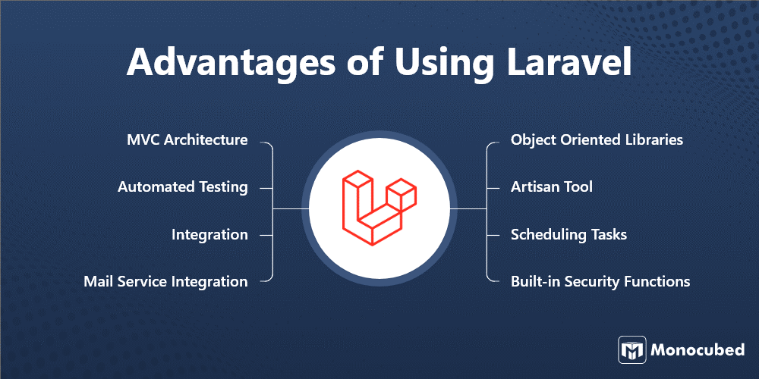
Advantages of Using Laravel
Dr. Ronak Panchal drronakpanchal.wordpress.com

Slide 10
Laravel 5.8 Requirement
Server Requirements:
Composer Software
PHP >= 7.1.3
OpenSSL PHP Extension
PDO PHP Extension
Mbstring PHP Extension
Tokenizer PHP Extension
XML PHP Extension
Ctype PHP Extension
JSON PHP Extension
Dr. Ronak Panchal drronakpanchal.wordpress.com

Slide 11
Laravel 6 Requirement
Server Requirements:
Composer Software
PHP >= 7.2
OpenSSL PHP Extension
PDO PHP Extension
Mbstring PHP Extension
Tokenizer PHP Extension
XML PHP Extension
Ctype PHP Extension
JSON PHP Extension
Note : to enable this extension goto c:/xampp/php/php.ini
Dr. Ronak Panchal drronakpanchal.wordpress.com

Slide 12
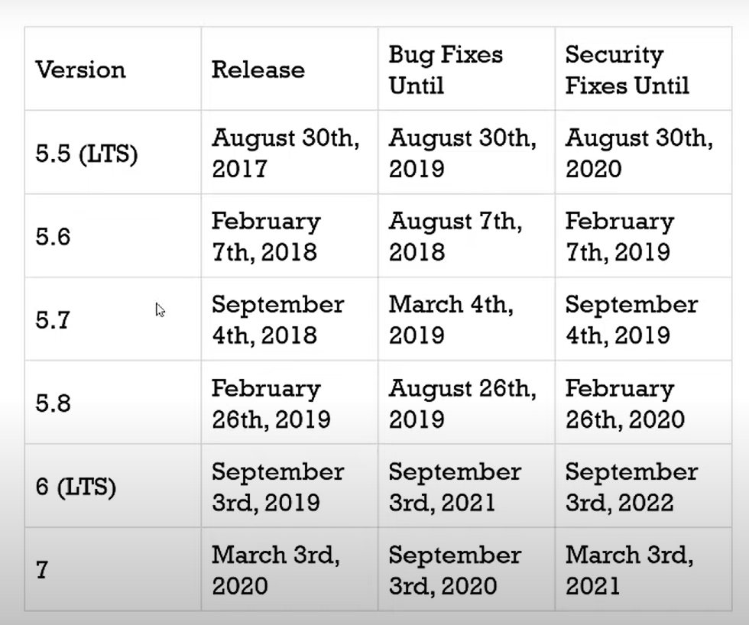
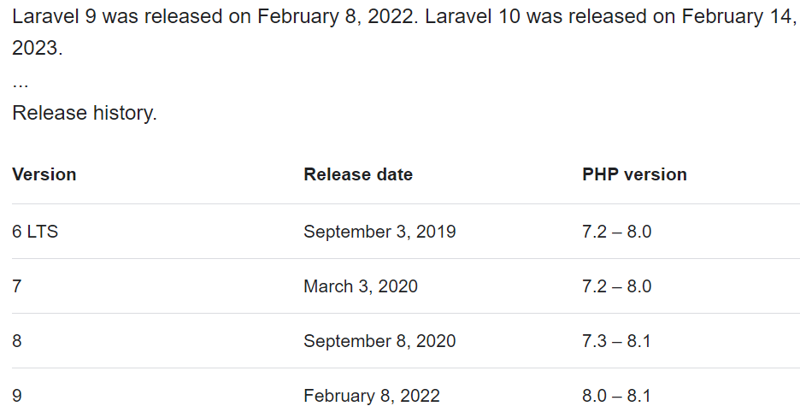
Version of Laravel
Dr. Ronak Panchal drronakpanchal.wordpress.com

Slide 13
Laravel Installation
#Laravel Notes

Slide 14
How To Install Laravel ?
Dr. Ronak Panchal drronakpanchal.wordpress.com

Slide 15
What is Composer ?
Composer is a tool for dependency management in PHP. It allows you to declare the libraries your project depends on and it will manage (install/update) them for you.
This means that Composer will pull in all the required libraries, dependencies and manage them all in one place.
This kind of management for dependencies in a project is not a new concept, and in fact, much of Composer is actually inspired from npm from Node.js and Bundlerfrom Ruby.
Dr. Ronak Panchal drronakpanchal.wordpress.com

Slide 16
Composer Solve The Following Problems
dependency resolution for PHP packages
auto loading solution for PHP packages
keeping all packages updated
Dr. Ronak Panchal drronakpanchal.wordpress.com

Slide 17
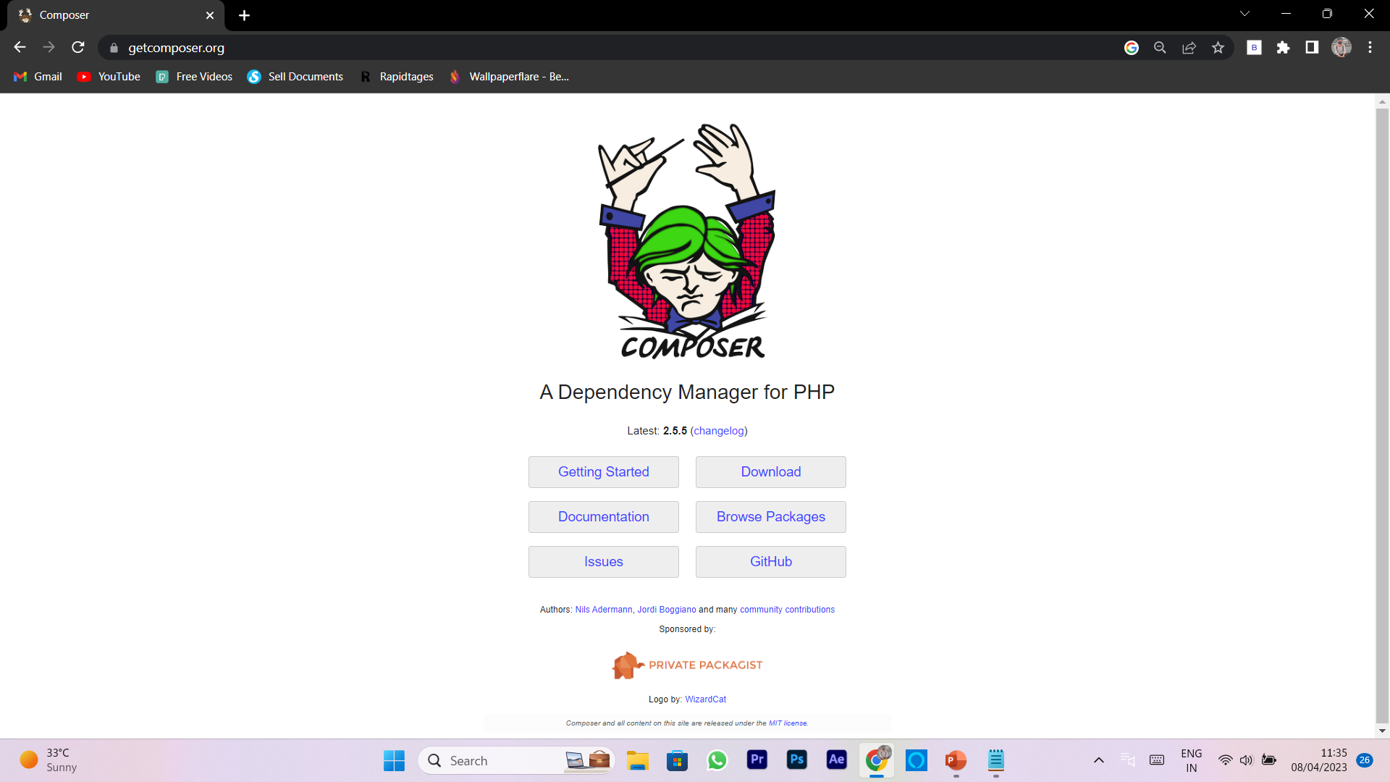
Install composer
Dr. Ronak Panchal drronakpanchal.wordpress.com

Slide 18
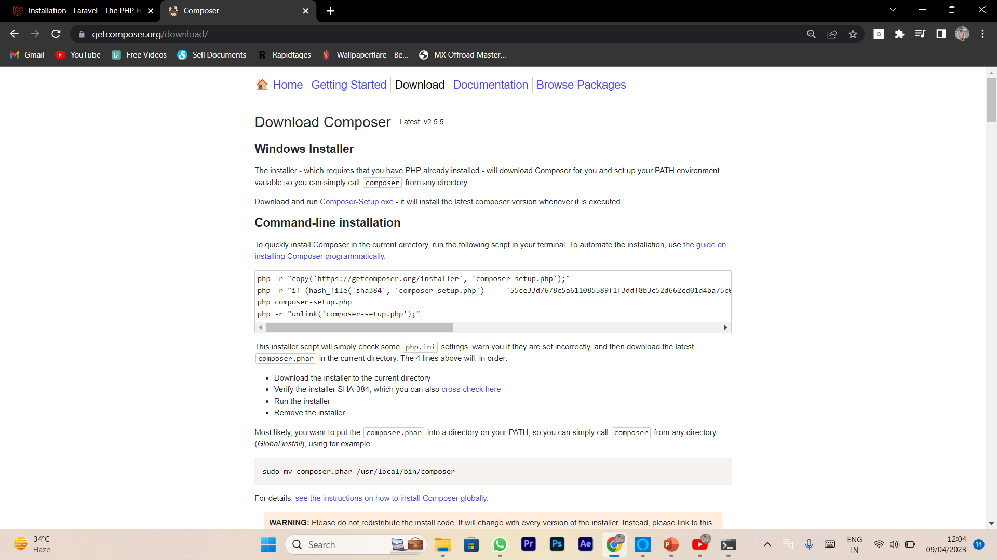
Install composer
Dr. Ronak Panchal drronakpanchal.wordpress.com

Slide 19
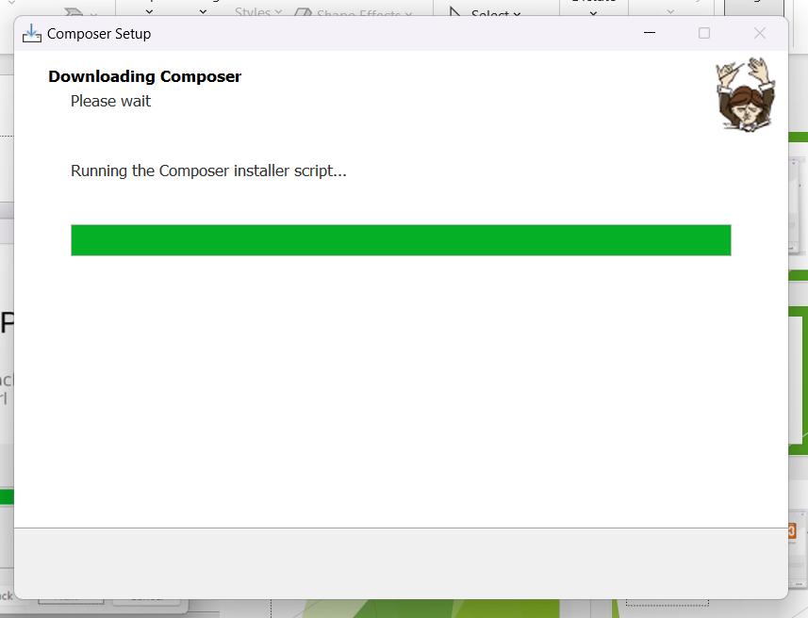
Install composer
Dr. Ronak Panchal drronakpanchal.wordpress.com

Slide 20
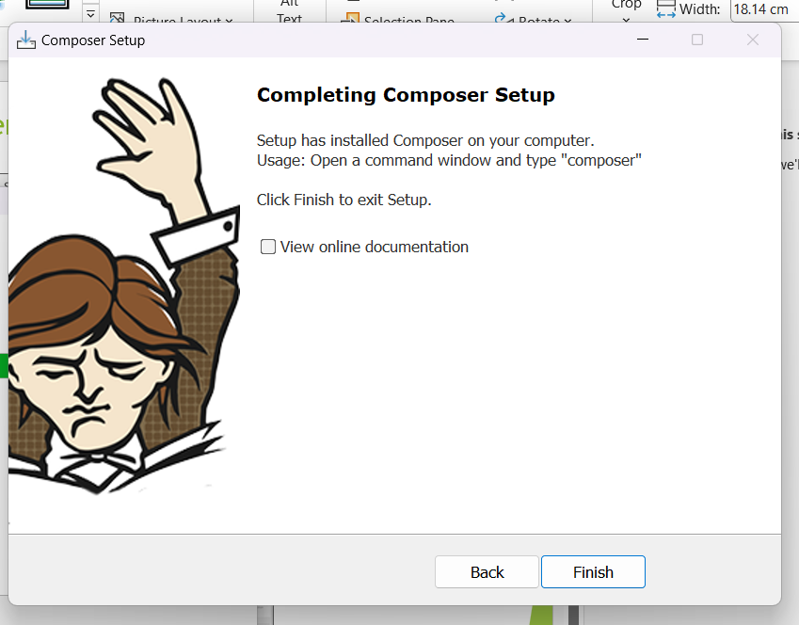
Install composer
Dr. Ronak Panchal drronakpanchal.wordpress.com

Slide 21
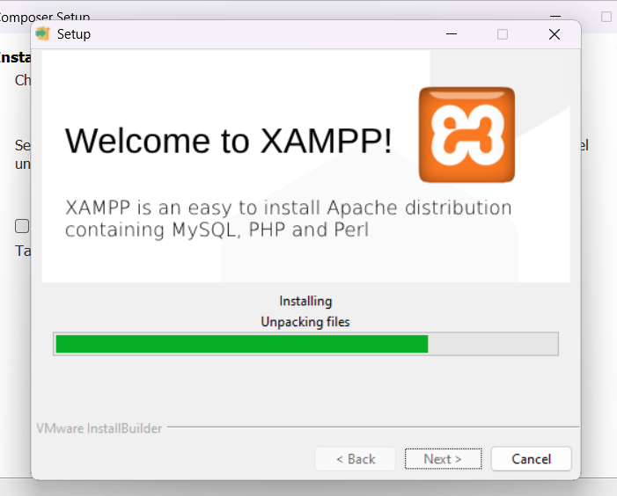
Install XAMPP
Dr. Ronak Panchal drronakpanchal.wordpress.com

Slide 22
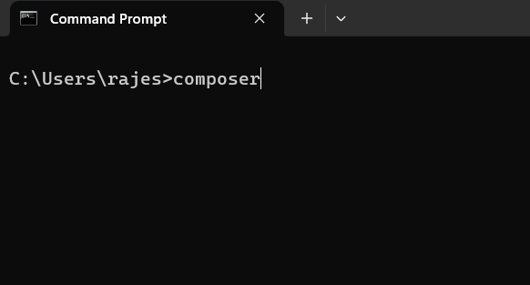
Testing command
Dr. Ronak Panchal drronakpanchal.wordpress.com

Slide 23
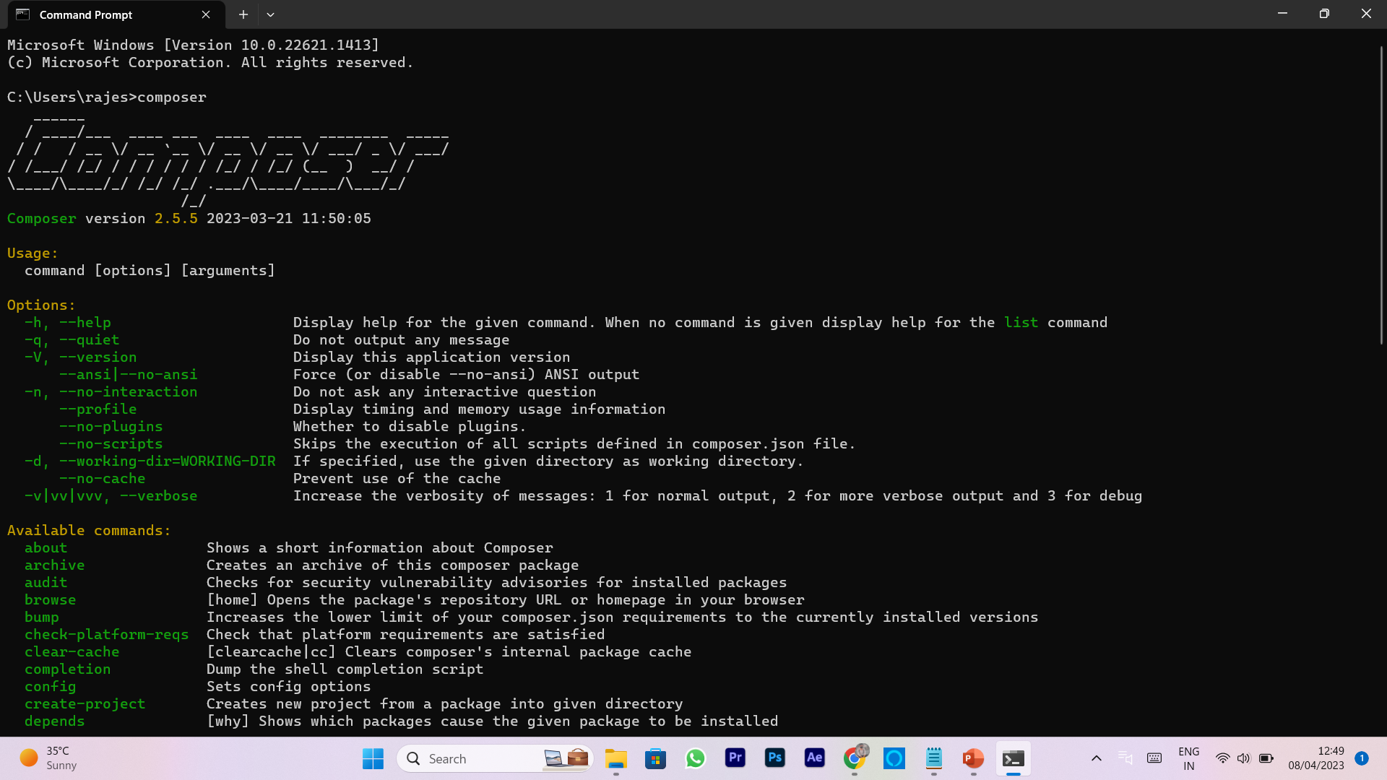
Testing command
Dr. Ronak Panchal drronakpanchal.wordpress.com

Slide 24
Composer Command
Open CMD:
Syntax :
Composer create-project vendorname/packagename projectname
Example :
composer create-project laravel/laravel test
Dr. Ronak Panchal drronakpanchal.wordpress.com

Slide 25
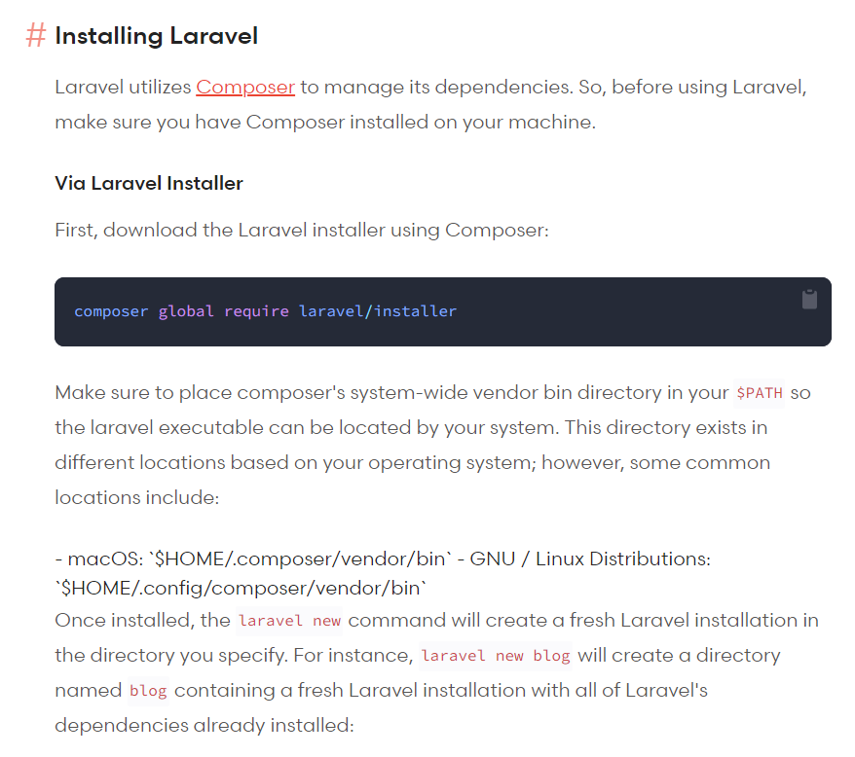
Laravel Download command
Dr. Ronak Panchal drronakpanchal.wordpress.com

Slide 26
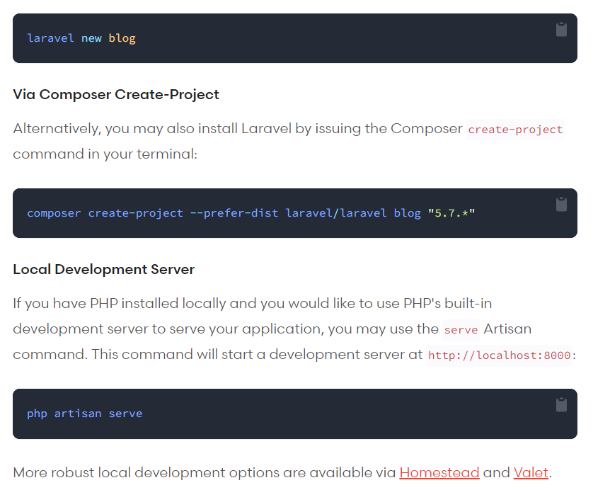
New Blog Create
Dr. Ronak Panchal drronakpanchal.wordpress.com

Slide 27
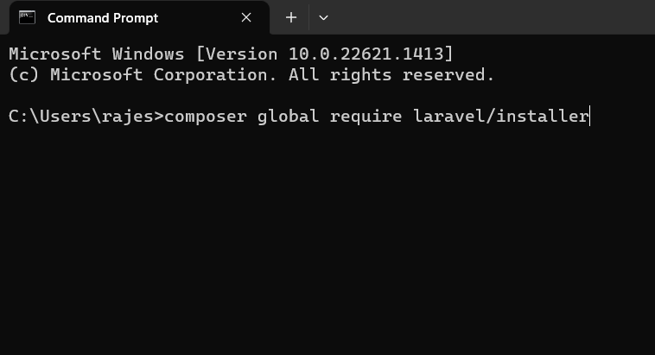
Download Laravel in Local PC
Dr. Ronak Panchal drronakpanchal.wordpress.com

Slide 28
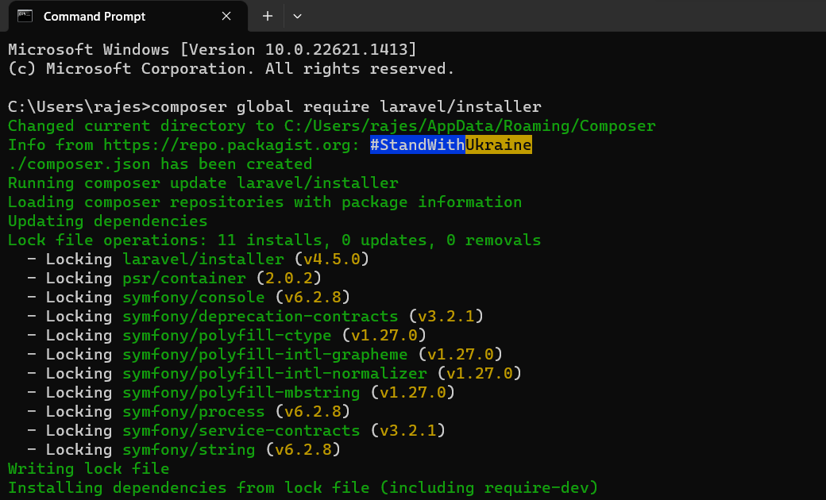
Downloading….
Dr. Ronak Panchal drronakpanchal.wordpress.com

Slide 29
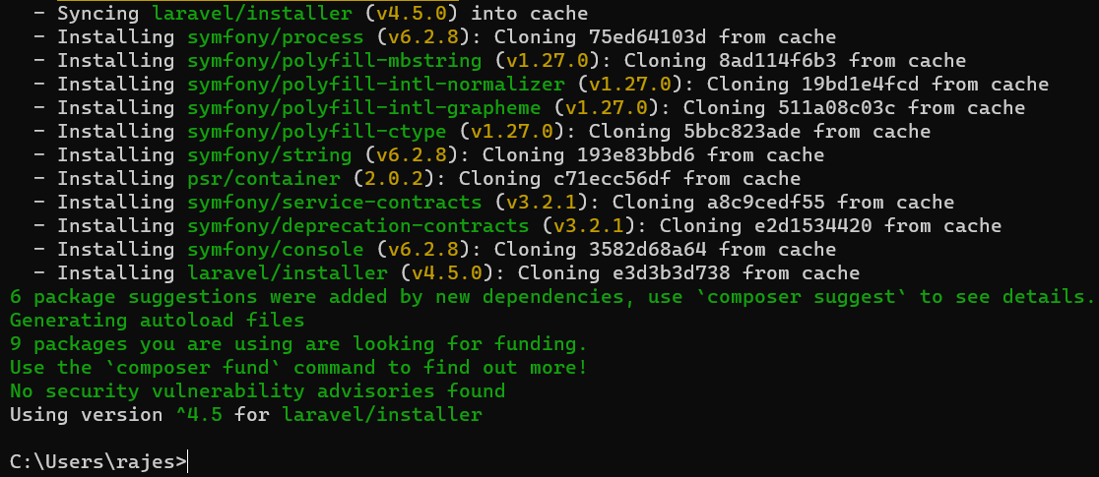
Installing….
Dr. Ronak Panchal drronakpanchal.wordpress.com

Slide 30
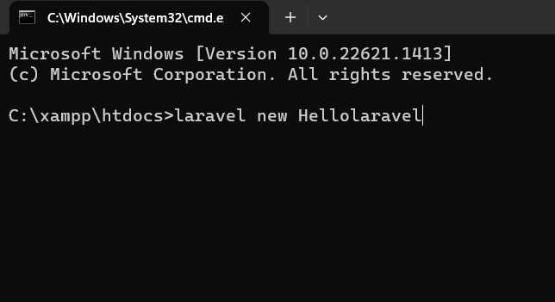
Navigate to Htdocs Create New Project
Dr. Ronak Panchal drronakpanchal.wordpress.com

Slide 31
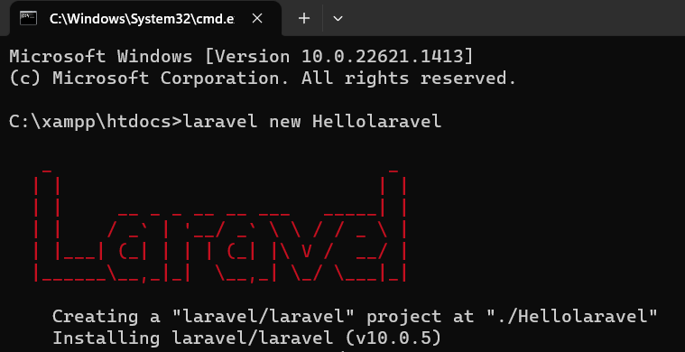
Dr. Ronak Panchal drronakpanchal.wordpress.com

Slide 32
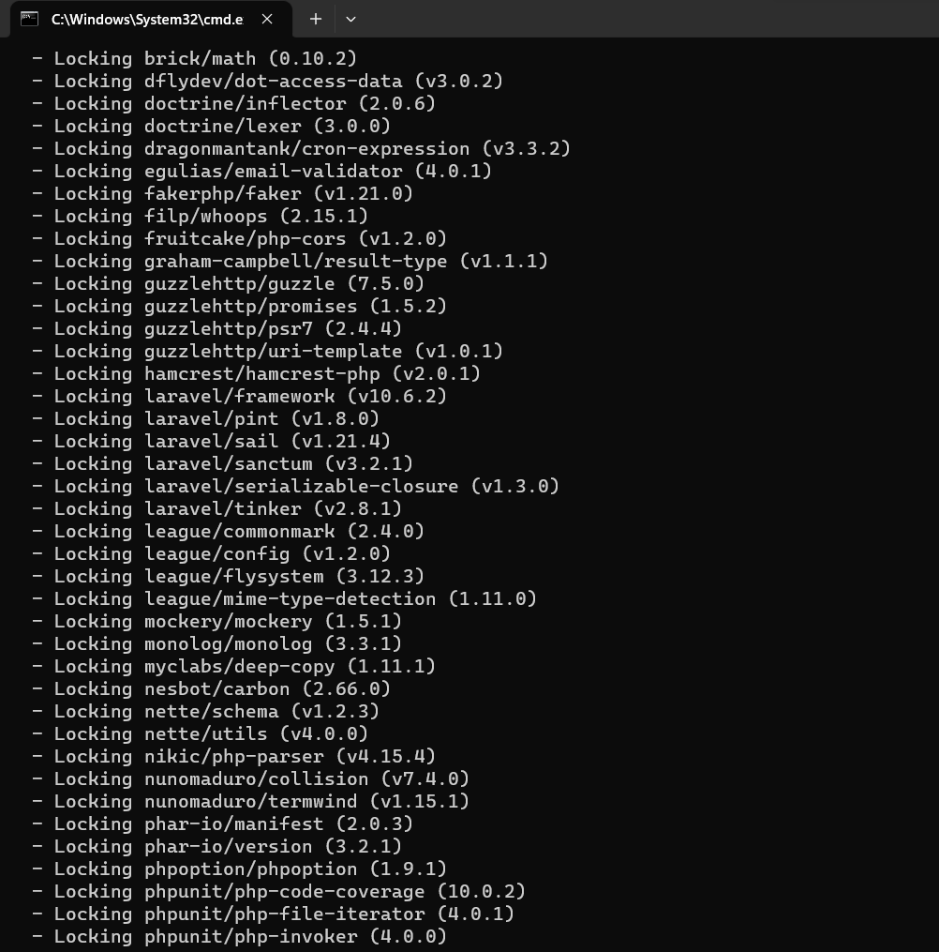
Dr. Ronak Panchal drronakpanchal.wordpress.com

Slide 33
Now, time to do practical….!
Let’s our hand dirty with coding…!

Slide 34
Thank You Question & Answer https://drronakpanchal.wordpress.com/
+919898257016 dr.ronak.k.Panchal@gmail.com

